Slide 1
ESE 2005 Embedded System Architecture I
Linchen Wang

Slide 2
Outline
Digital Building Blocks
Carry-Lookahead Adder
Prefix Adder
Subtraction
Power consumption

Slide 3
Digital Building Blocks
We talk more combinational and sequential building blocks used in digital systems. Including arithmetic circuits, counters, shift registers, memory arrays, and logic arrays.

Slide 4
Arithmetic circuits
Arithmetic circuits are the central building blocks of computers. Computers and digital logic perform many arithmetic functions: addition, subtraction, comparisons, shifts, multiplication, and division.

Slide 5
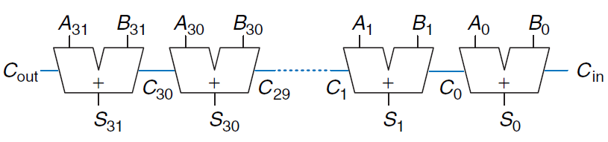


Adder
We talked about the half adder, full adder, and ripple-carry adder.
We say that the carry ripples through the carry chain. The delay of the adder, $t_{\text{ripple}}$, grows directly with the number of bits, and $t_{\text{FA}}$ is the delay of a full adder.

Slide 6
Carry-Lookahead Adder
The fundamental reason that large ripple-carry adders are slow is that the carry signals must propagate through every bit in the adder.
A carry-lookahead adder (CLA) is another type of carry propagate adder that solves this problem by dividing the adder into blocks and providing circuitry to quickly determine the carry out of a block as soon as the carry in is known. Thus it is said to look ahead across the blocks rather than waiting to ripple through all the full adders inside a block. For example, a 32-bit adder may be divided into eight 4-bit blocks.

Slide 7
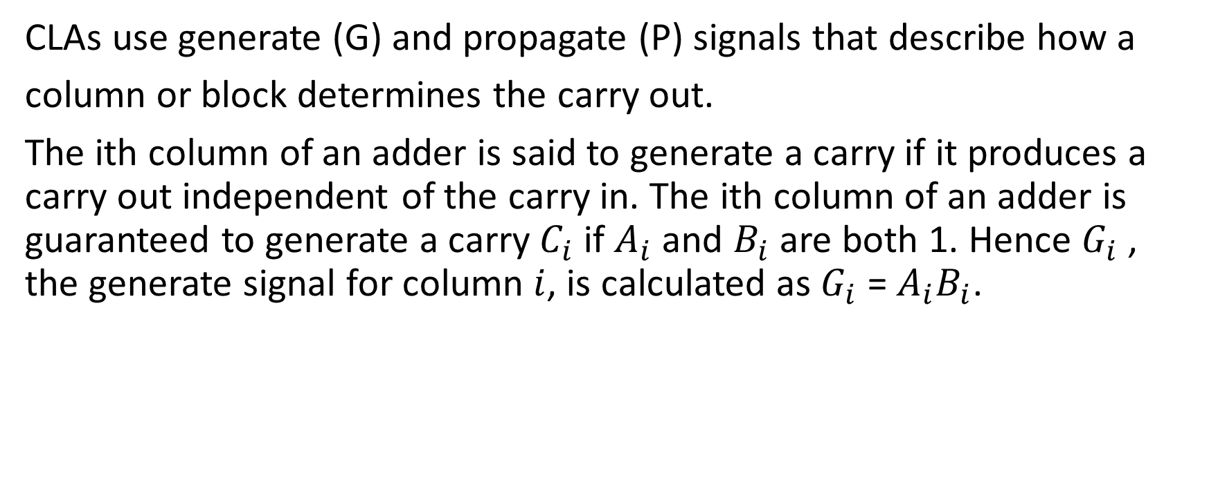
Carry-Lookahead Adder
CLAs use generate (G) and propagate (P) signals that describe how a
column or block determines the carry out.
The ith column of an adder is said to generate a carry if it produces a carry out independent of the carry in. The ith column of an adder is guaranteed to generate a carry $C_{i}$ if $A_{i}$ and $B_{i}$ are both 1. Hence $G_{i}$ , the generate signal for column $i$, is calculated as $G_{i}$ = $A_{i}B_{i}$.

Slide 8
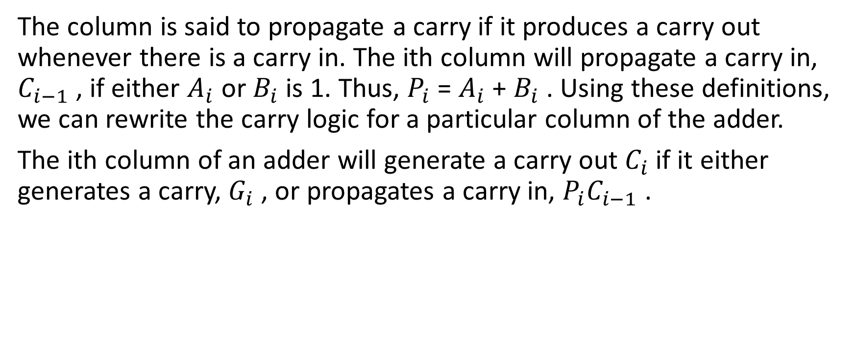
Carry-Lookahead Adder
The column is said to propagate a carry if it produces a carry out whenever there is a carry in. The ith column will propagate a carry in, $C_{i−1}$ , if either $A_{i}$ or $B_{i}$ is 1. Thus, $P_{i}$ = $A_{i}$ + $B_{i}$ . Using these definitions, we can rewrite the carry logic for a particular column of the adder.
The ith column of an adder will generate a carry out $C_{i}$ if it either generates a carry, $G_{i}$ , or propagates a carry in, $P_{i}C_{i−1}$ .

Slide 9
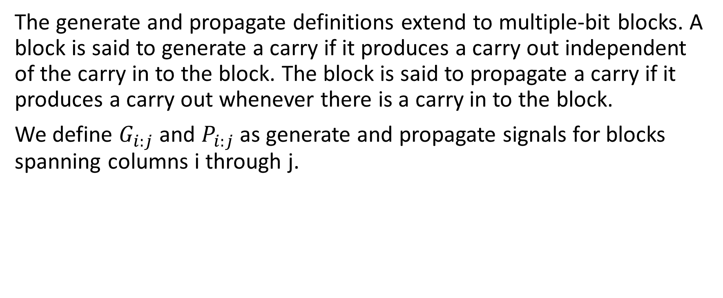
Carry-Lookahead Adder
The generate and propagate definitions extend to multiple-bit blocks. A block is said to generate a carry if it produces a carry out independent of the carry in to the block. The block is said to propagate a carry if it produces a carry out whenever there is a carry in to the block.
We define $G_{i:j}$ and $P_{i:j}$ as generate and propagate signals for blocks spanning columns i through j.

Slide 10

Carry-Lookahead Adder
A block generates a carry if the most significant column generates a carry, or if the most significant column propagates a carry and the previous column generated a carry, and so forth. For example, the generate logic for a block spanning columns 3 through 0 is
A block propagates a carry if all the columns in the block propagate the carry.

Slide 11


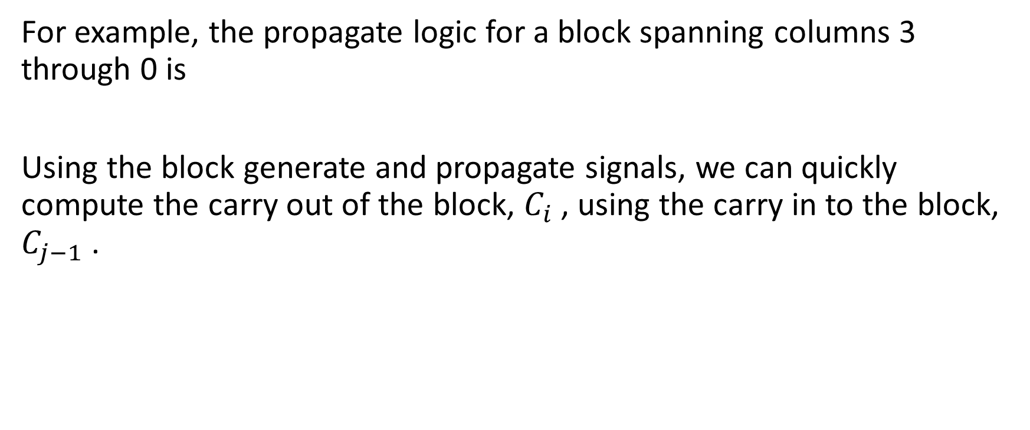
Carry-Lookahead Adder
For example, the propagate logic for a block spanning columns 3 through 0 is
Using the block generate and propagate signals, we can quickly compute the carry out of the block, $C_{i}$ , using the carry in to the block, $C_{j−1}$ .

Slide 12
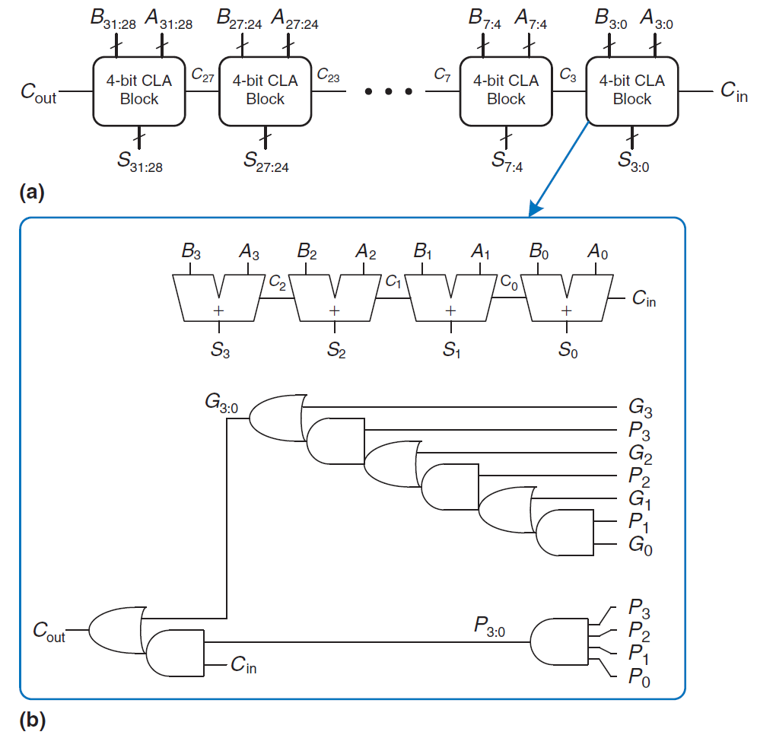
Carry-Lookahead Adder
Here (a) is a 32-bit carry-lookahead adder composed of eight 4-bit blocks.
Each block (b) contains a 4-bit ripple-carry adder and some lookahead logic to compute the carry out of the block given the carry in.

Slide 13
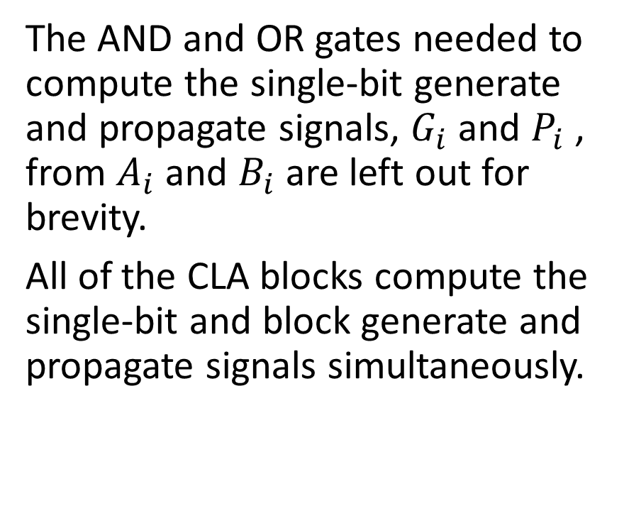
Carry-Lookahead Adder
The AND and OR gates needed to compute the single-bit generate and propagate signals, $G_{i}$ and $P_{i}$ , from $A_{i}$ and $B_{i}$ are left out for brevity.
All of the CLA blocks compute the single-bit and block generate and propagate signals simultaneously.

Slide 14
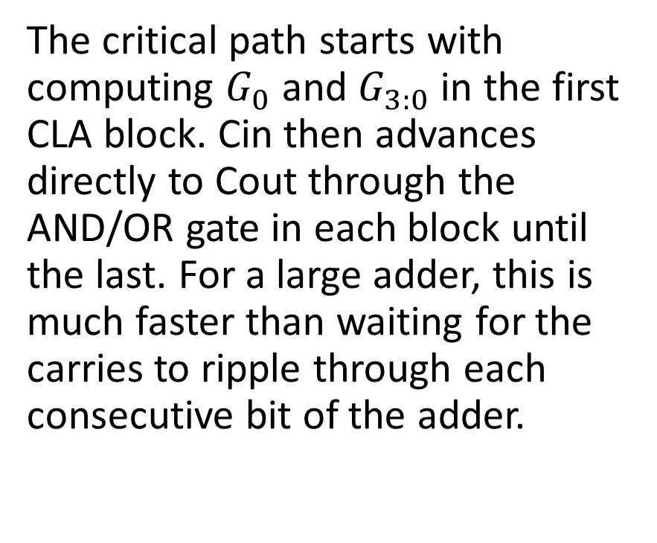
Carry-Lookahead Adder
The critical path starts with computing $G_{0}$ and $G_{3:0}$ in the first CLA block. Cin then advances directly to Cout through the AND/OR gate in each block until the last. For a large adder, this is much faster than waiting for the carries to ripple through each consecutive bit of the adder.

Slide 15

Carry-Lookahead Adder
Finally, the critical path through the last block contains a short ripple-carry adder. Thus, an N-bit adder divided into k-bit blocks has a delay

Slide 16
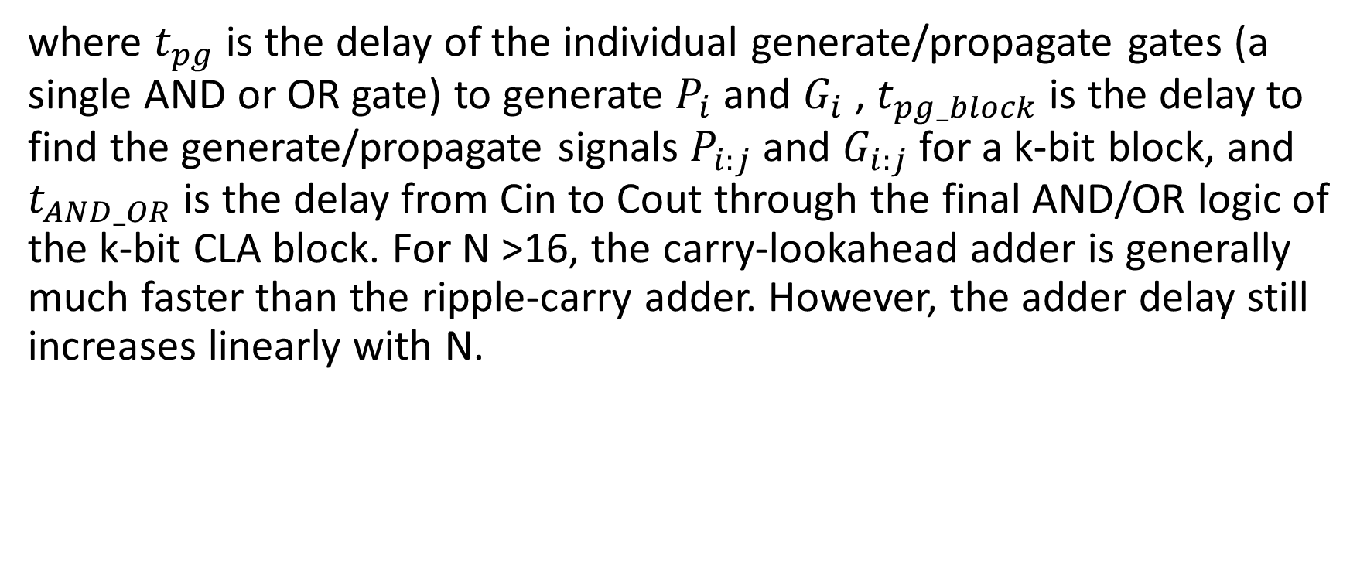
Carry-Lookahead Adder
where $t_{pg}$ is the delay of the individual generate/propagate gates (a single AND or OR gate) to generate $P_{i}$ and $G_{i}$ , $t_{pg_block}$ is the delay to find the generate/propagate signals $P_{i:j}$ and $G_{i:j}$ for a k-bit block, and $t_{AND_OR}$ is the delay from Cin to Cout through the final AND/OR logic of the k-bit CLA block. For N >16, the carry-lookahead adder is generally much faster than the ripple-carry adder. However, the adder delay still increases linearly with N.

Slide 17

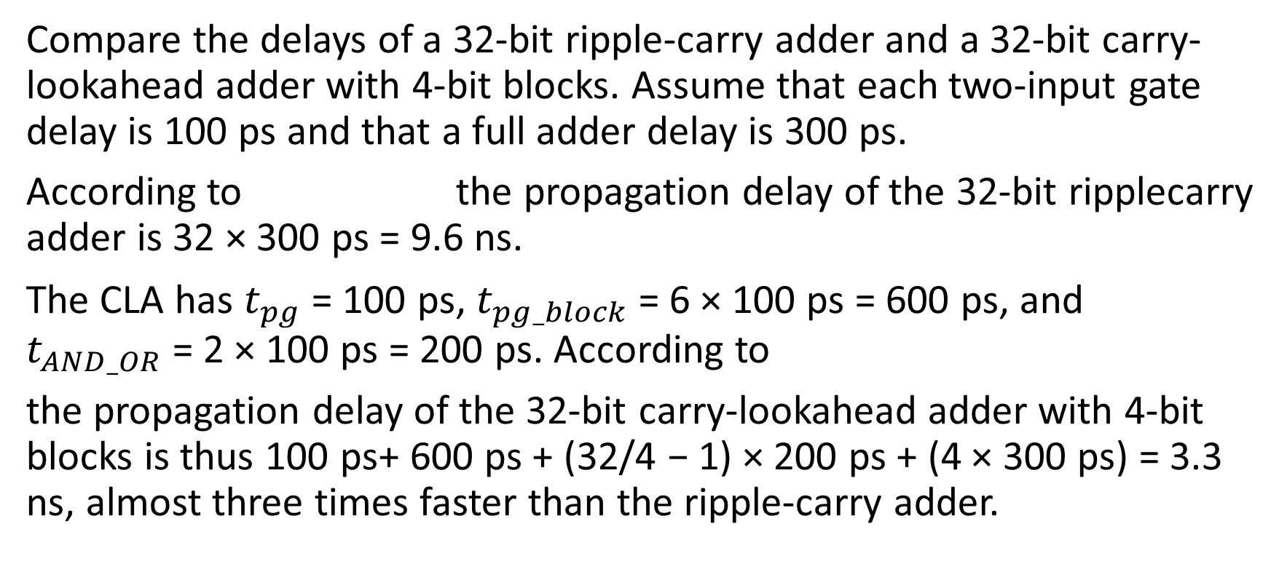
RIPPLE-CARRY ADDER AND CARRY-LOOKAHEAD ADDER DELAY
Compare the delays of a 32-bit ripple-carry adder and a 32-bit carry-lookahead adder with 4-bit blocks. Assume that each two-input gate delay is 100 ps and that a full adder delay is 300 ps.
According to the propagation delay of the 32-bit ripplecarry adder is 32 × 300 ps = 9.6 ns.
The CLA has $t_{pg}$ = 100 ps, $t_{pg_block}$= 6 × 100 ps = 600 ps, and $t_{AND_OR}$= 2 × 100 ps = 200 ps. According to
the propagation delay of the 32-bit carry-lookahead adder with 4-bit blocks is thus 100 ps+ 600 ps + (32/4 − 1) × 200 ps + (4 × 300 ps) = 3.3 ns, almost three times faster than the ripple-carry adder.

Slide 18

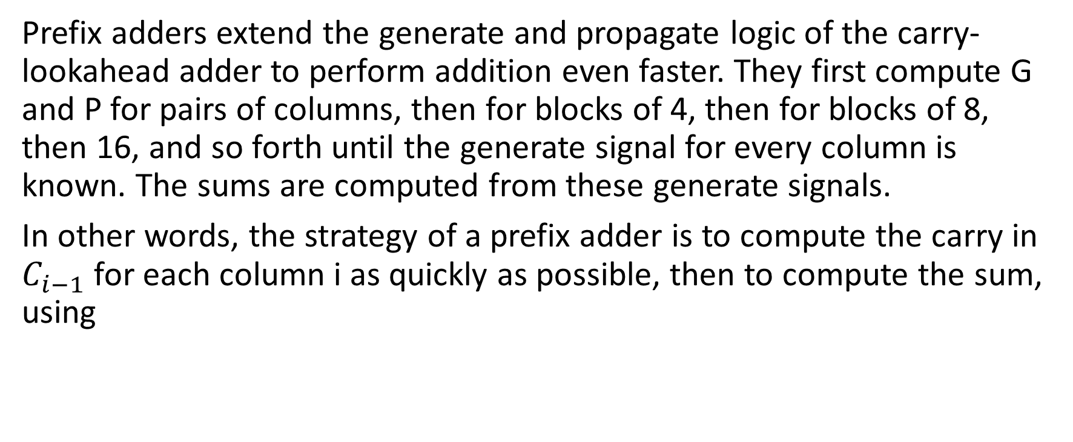
Prefix Adder
Prefix adders extend the generate and propagate logic of the carry-lookahead adder to perform addition even faster. They first compute G and P for pairs of columns, then for blocks of 4, then for blocks of 8, then 16, and so forth until the generate signal for every column is known. The sums are computed from these generate signals.
In other words, the strategy of a prefix adder is to compute the carry in $C_{i−1}$ for each column i as quickly as possible, then to compute the sum, using
Notes:
Early computers used ripplecarry adders, because components were expensive and ripple-carry adders used the least hardware. Virtually all modern PCs use prefix adders on critical paths, because transistors are now cheap and speed is of great importance.

Slide 19

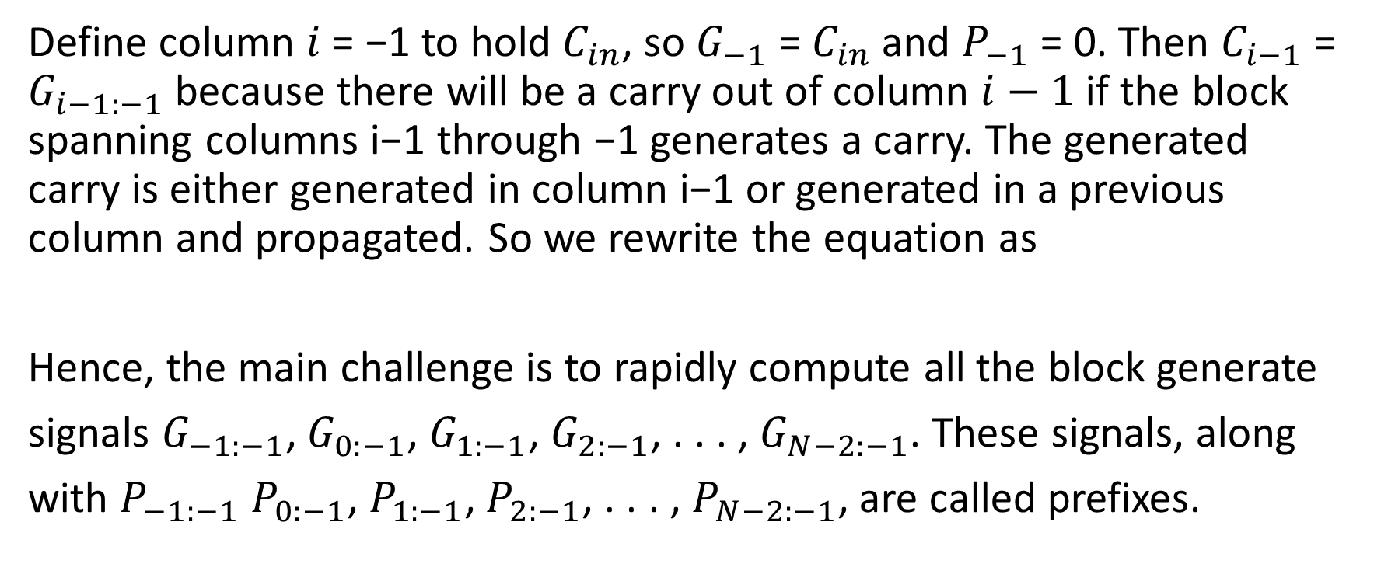
Prefix Adder
Define column $i$ = −1 to hold $C_{in}$, so $G_{−1}$ = $C_{in}$ and $P_{−1}$ = 0. Then $C_{i−1}$ = $G_{i−1:−1}$ because there will be a carry out of column $i−1$ if the block spanning columns i−1 through −1 generates a carry. The generated carry is either generated in column i−1 or generated in a previous column and propagated. So we rewrite the equation as
Hence, the main challenge is to rapidly compute all the block generate
signals $G_{−1:−1}$, $G_{0:−1}$, $G_{1:−1}$, $G_{2:−1}$, . . . , $G_{N−2:−1}$. These signals, along
with $P_{−1:−1}$ $P_{0:−1}$, $P_{1:−1}$, $P_{2:−1}$, . . . , $P_{N−2:−1}$, are called prefixes.

Slide 20
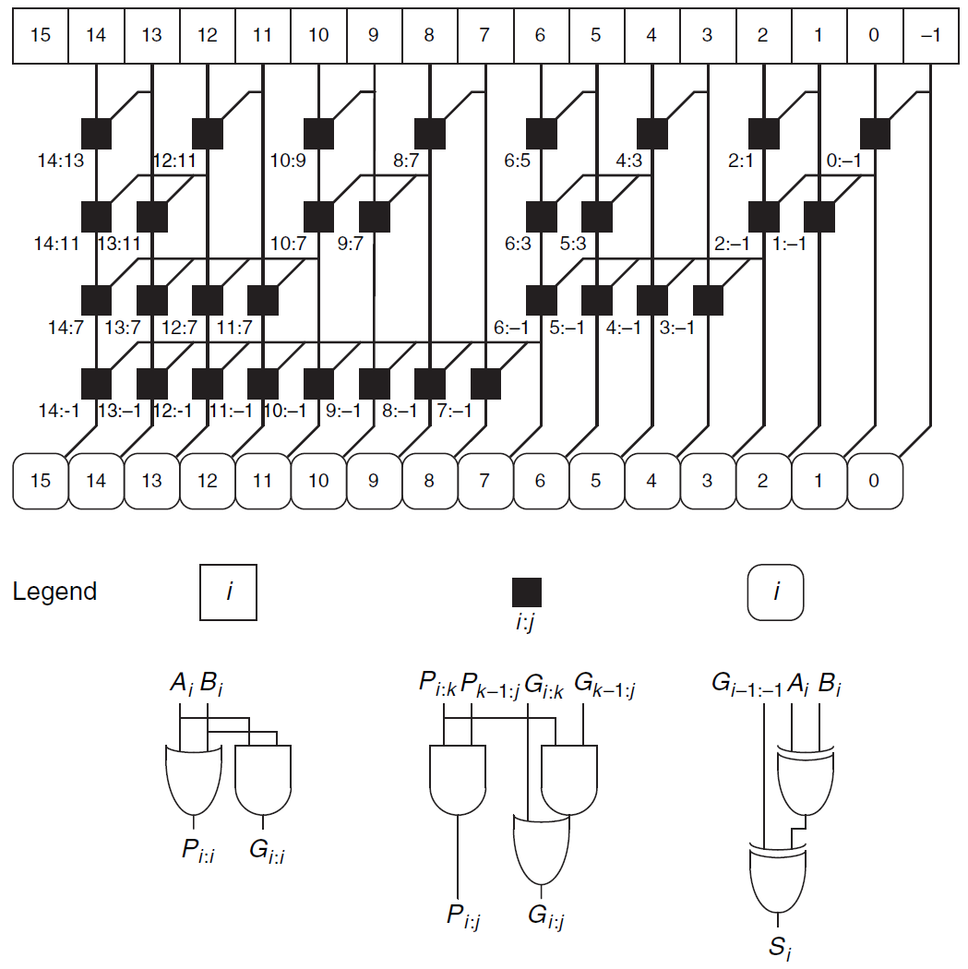
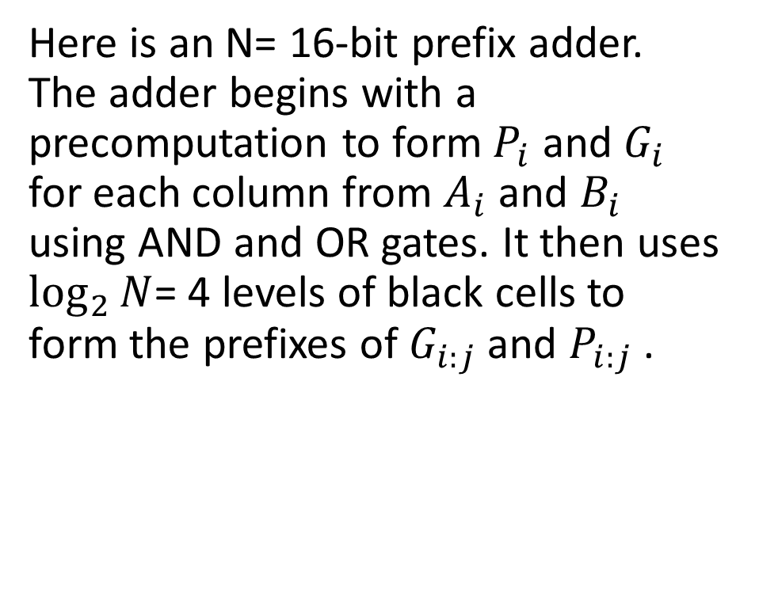
Prefix Adder
Here is an N= 16-bit prefix adder. The adder begins with a precomputation to form $P_{i}$ and $G_{i}$ for each column from $A_{i}$ and $B_{i}$ using AND and OR gates. It then uses $\log_{2}{N}$= 4 levels of black cells to form the prefixes of $G_{i:j}$ and $P_{i:j}$ .

Slide 21
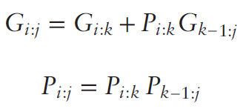
Prefix Adder
A black cell takes inputs from the upper part of a block spanning bits i:k and from the lower part spanning bits k−1:j. It combines these parts to form generate and propagate signals for the entire block spanning bits i:j using the equations

Slide 22

Prefix Adder
In other words, a block spanning bits i:j will generate a carry if the upper part generates a carry or if the upper part propagates a carry generated in the lower part. The block will propagate a carry if both the upper and lower parts propagate the carry. Finally, the prefix adder computes the sums using

Slide 23
Prefix Adder
In summary, the prefix adder achieves a delay that grows logarithmically rather than linearly with the number of columns in the adder. This speedup is significant, especially for adders with 32 or more bits, but it comes at the expense of more hardware than a simple carry-lookahead adder. The network of black cells is called a prefix tree.

Slide 24

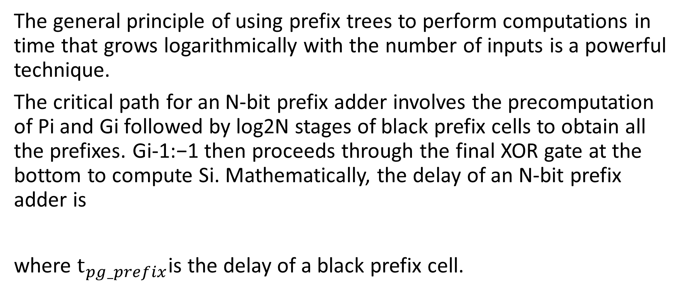
Prefix Adder
The general principle of using prefix trees to perform computations in time that grows logarithmically with the number of inputs is a powerful technique.
The critical path for an N-bit prefix adder involves the precomputation of Pi and Gi followed by log2N stages of black prefix cells to obtain all the prefixes. Gi-1:−1 then proceeds through the final XOR gate at the bottom to compute Si. Mathematically, the delay of an N-bit prefix adder is
where $t_{pg_prefix}$is the delay of a black prefix cell.

Slide 25
Prefix Adder
Compute the delay of a 32-bit prefix adder. Assume that each two-input gate delay is 100 ps.
The propagation delay of each black prefix cell tpg_prefix is 200 ps (i.e., two gate delays). Thus, using
The propagation delay of the 32-bit prefix adder is 100 ps + log2(32) × 200 ps + 100 ps = 1.2 ns, which is about three times faster than the carry-lookahead adder and eight times faster than the ripple-carry adder from last example.

Slide 26
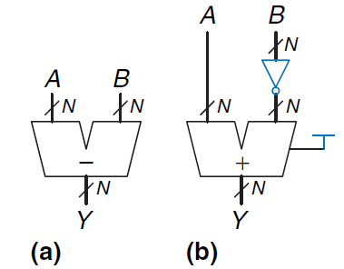
Subtraction
Recall that adders can add positive and negative numbers using two’s complement number representation. Subtraction is almost as easy: flip the sign of the second number, then add. Flipping the sign of a two’s complement number is done by inverting the bits and adding 1.
Notes:
CPA carry propagate adder

Slide 27
Subtraction
To compute Y = A − B, first create the two’s complement of B: Invert the bits of B to obtain B and add 1 to get −B = B + 1. Add this quantity to A to get Y = A + B + 1 = A − B. This sum can be performed with a single CPA by adding A + B with Cin = 1.
Notes:
CPA carry propagate adder

Slide 28
Subtraction
Here shows the symbol for a subtractor and the underlying hardware for performing Y = A − B.
Subtractor:
(a) symbol
(b) implementation
Notes:
CPA carry propagate adder

Slide 29
Power consumption
Power consumption is the amount of energy used per unit time. Power consumption is of great importance in digital systems. The battery life of portable systems such as cell phones and laptop computers is limited by power consumption. Power is also significant for systems that are plugged in, because electricity costs money and because the system will overheat if it draws too much power.

Slide 30
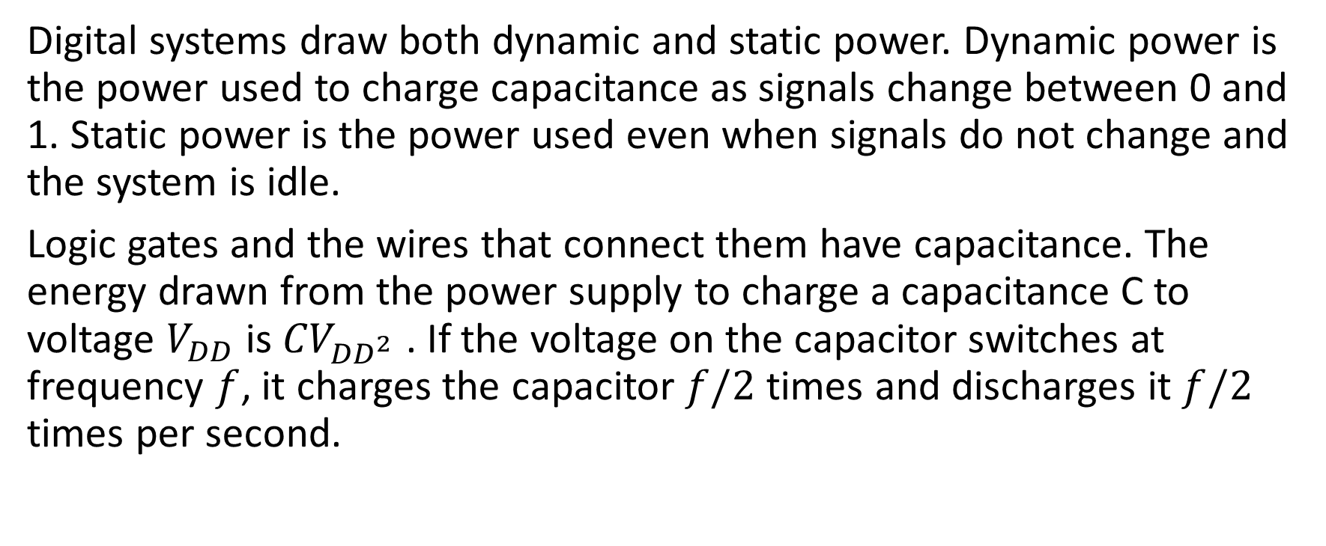
Power consumption
Digital systems draw both dynamic and static power. Dynamic power is the power used to charge capacitance as signals change between 0 and 1. Static power is the power used even when signals do not change and the system is idle.
Logic gates and the wires that connect them have capacitance. The energy drawn from the power supply to charge a capacitance C to voltage $V_{DD}$ is ${CV}_{{DD}^{2}}$ . If the voltage on the capacitor switches at frequency $f$, it charges the capacitor $f/2$ times and discharges it $f/2$ times per second.

Slide 31


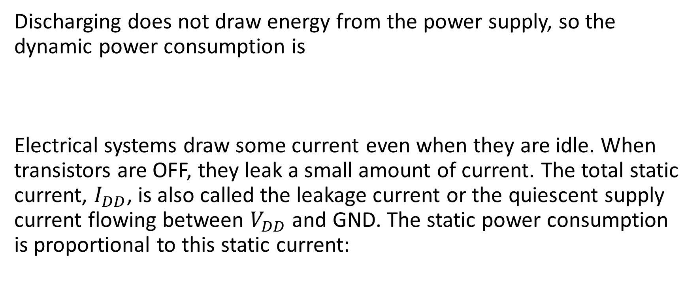
Power consumption
Discharging does not draw energy from the power supply, so the dynamic power consumption is
Electrical systems draw some current even when they are idle. When transistors are OFF, they leak a small amount of current. The total static current, $I_{DD}$, is also called the leakage current or the quiescent supply current flowing between $V_{DD}$ and GND. The static power consumption is proportional to this static current:

